Slide 1

GIANT TECH COMPANIES
Supervised by:
PRESENTED BY: 1.Alimul Islam Eram Khan
2.Zarin Tasnim Roichi
3.Mahabobul Alam Tushar
Student ID: 1.20210104110
2.20210104111
3.20210104112
SECTION: C
GROUP: CSE(C1)
COURSE: CSE-1108
1.Mr. Shoeb Mohammad Shahriar
Dept of CSE;Ahsanullah University of Science & Technology
2.Mr. Md. Reasad Zaman Chowdhury
Dept of CSE;Ahsanullah University of Science & Technology

Slide 2


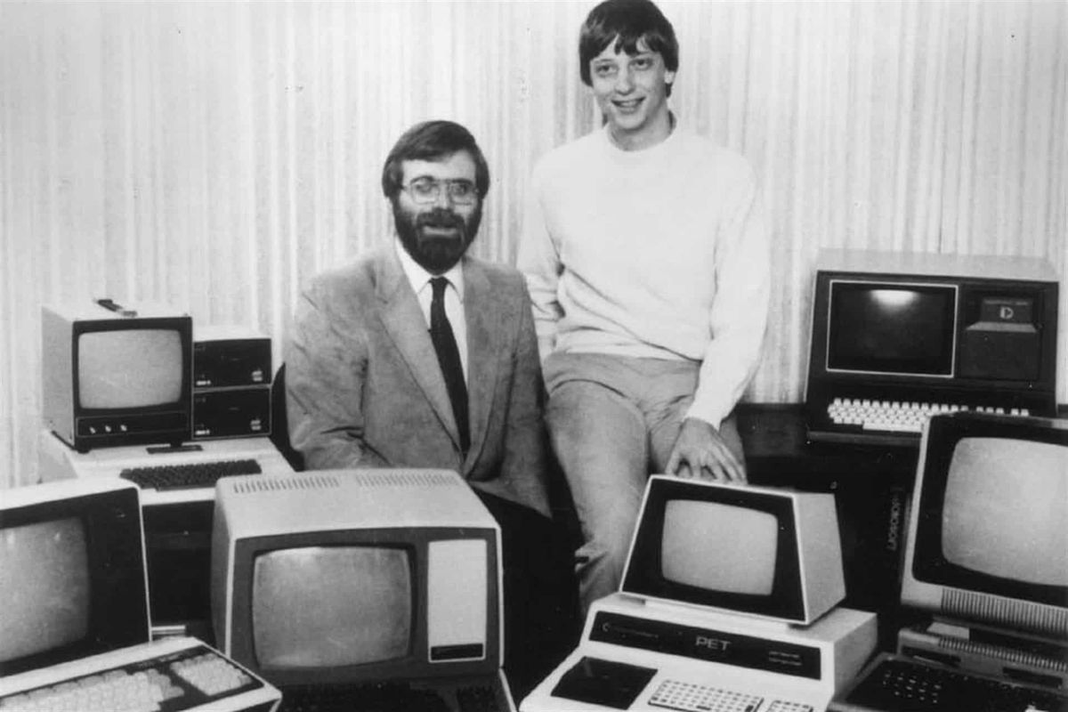
MICROSOFT
“YOUR POTENTIAL,OUR PASSION.”
Founder, Bill Gates & Allen Paul
Owner ,Bill Gates

Slide 3

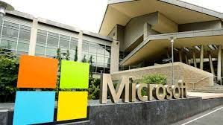
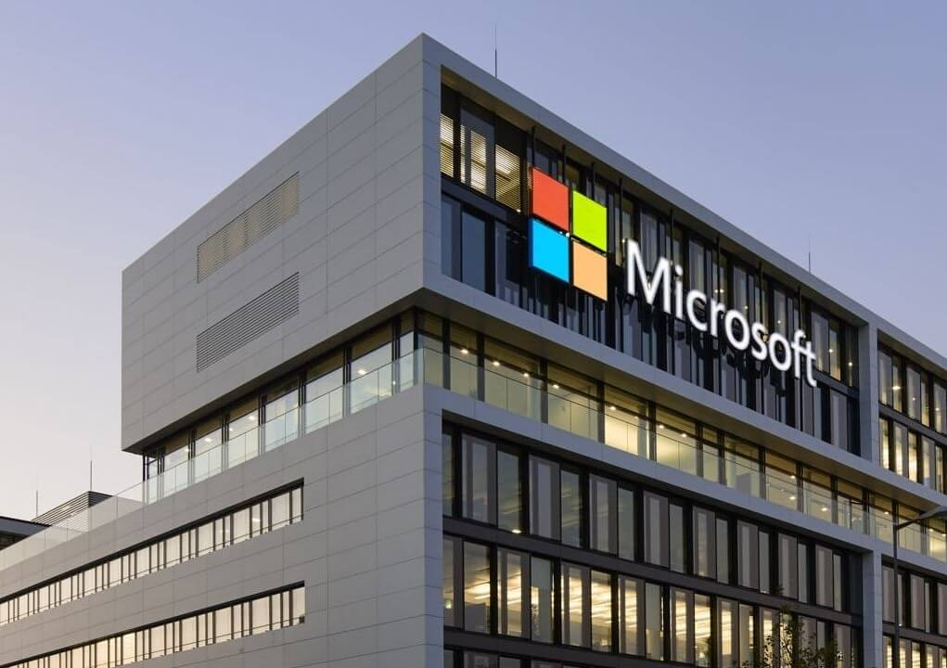
HISTORY OF MICROSOFT COMPANY:
4 April 1975:The Beginning
Bill gates and Paul allen started as their hobby in high school, inspired by altair 8800
It was created for developing and selling basic interpreters
1984-1994:Windows and Office
2006:Vista and Cloud Computing
1995-2005:Inter and the 32-bit era
The largest company to create computer software.
Head quarter in Redmond, Washington
Subsidiary offices in more than 60 countries

Slide 4

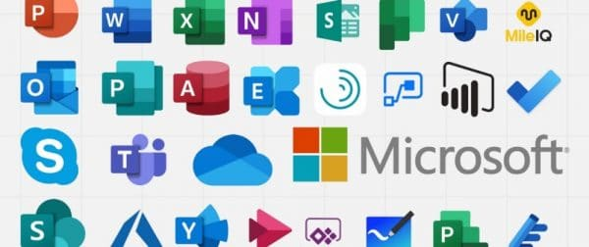
SOME PRODUCT FROM MICROSOFT:
Skype for business
Exchange Server
Dynamics ERP
Microsoft Azure
Share Point Server
SQL Server
Windows Client
Microsoft Office suit

Slide 5
Segments of Microsoft companies products:

Slide 6
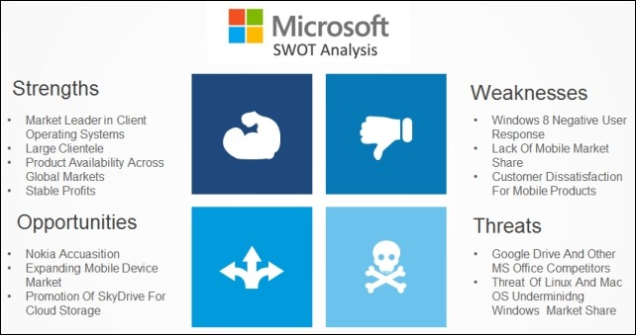
SWOT ANALYSIS:

Slide 7
COMPETETORS OF MICROSOFT COMPANY:

Slide 8
MICROSOFT’S NET INCOME FROM 2002 TO 2021:

Slide 9

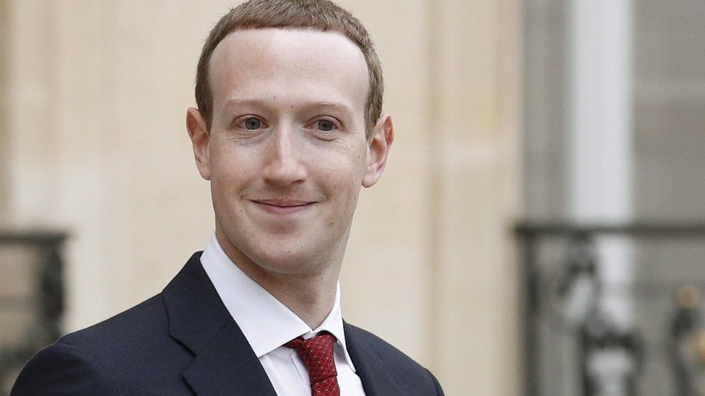
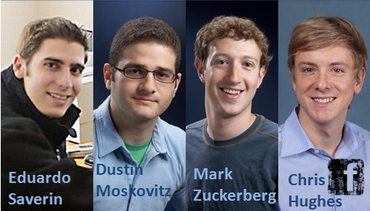
FACEBOOK
FOUNDERS OF FACEBOOK
CEO, MARK ZUCKERBERG

Slide 10

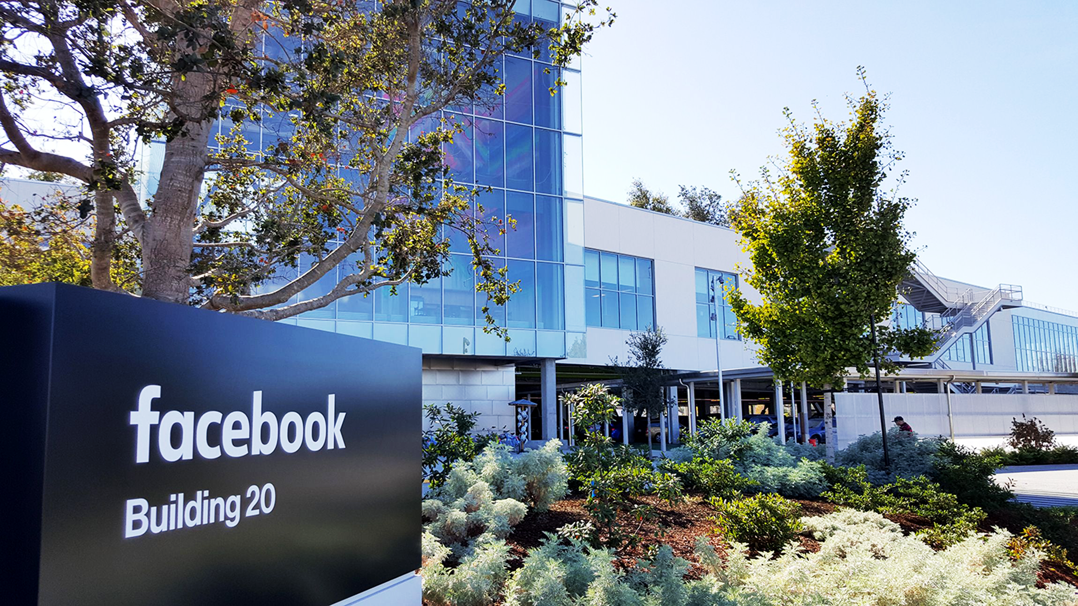
HISTORY OF META COMPANY:
On February 4,2004
It was launched by Mark Zuckerberg
With Harvard college student and roommates
The founders had initially limited the websites membership to Harvard students only.
On September 26,2006,it was to everyone at least age 13 with a valid email address.
main office, Menlo Park, California, United States

Slide 11
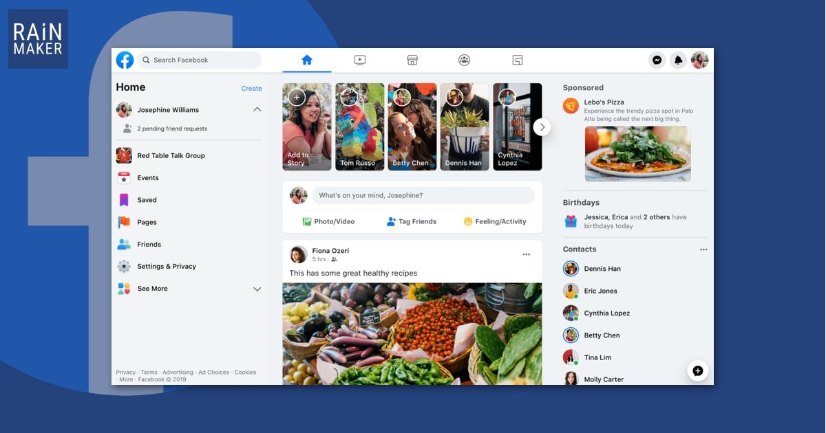

FEATURES:
Facebook chat
“Friending”: Sending friend request to users
Photos, Videos
Tags
Likes and Comments
Allows to create online page and groups
Poke: Gesture to attract another user’s attention
Notifications
Share
Newsfeed, Follow
Location
Online games

Slide 12

Facebook’s annual revenue from 2009 to 2020(In million US dollar)

Slide 13

Distribution of Facebook users worldwide as of October 2021 by age and gender

Slide 14

BENEFITS:
1.Easy to use
2.A connecting tool to stay in touch with family and friends
3.One can freely express thoughts and ideas
CRITISISM:
1.Time consuming
2.Facebook Addiction
3.Privacy consideration
4.Scams
CONCLUSION:
1.The most famous social networking site
2.It is widely used by the people
3.It helps to be interactive with family and friends

Slide 15

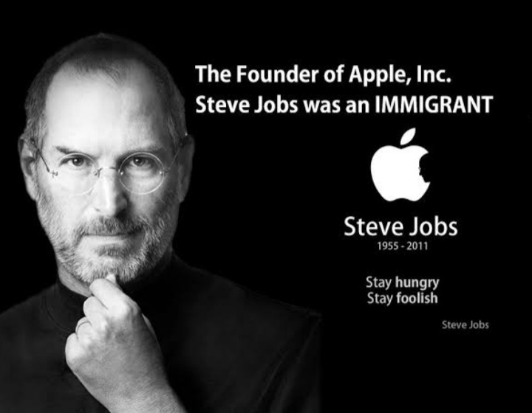
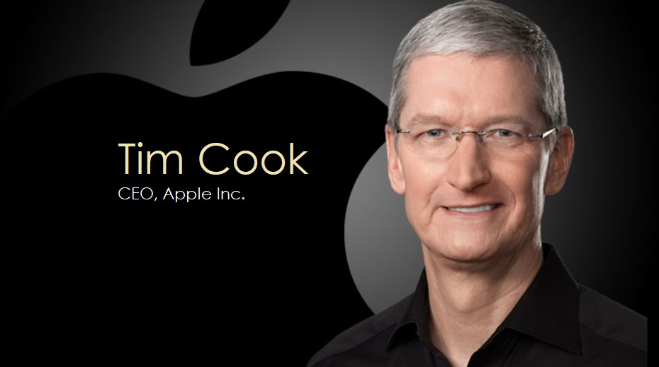
“THINK DIFFERENT”

Slide 16

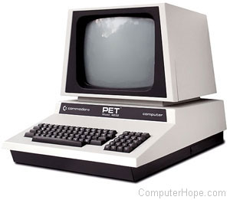
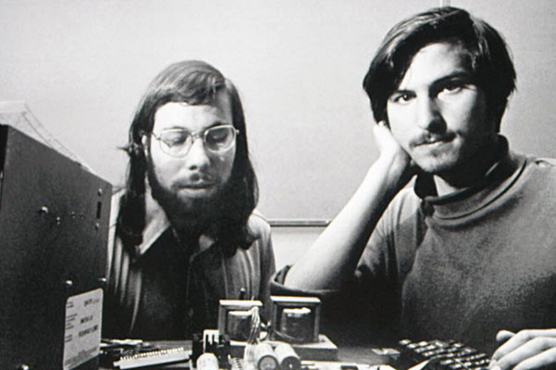
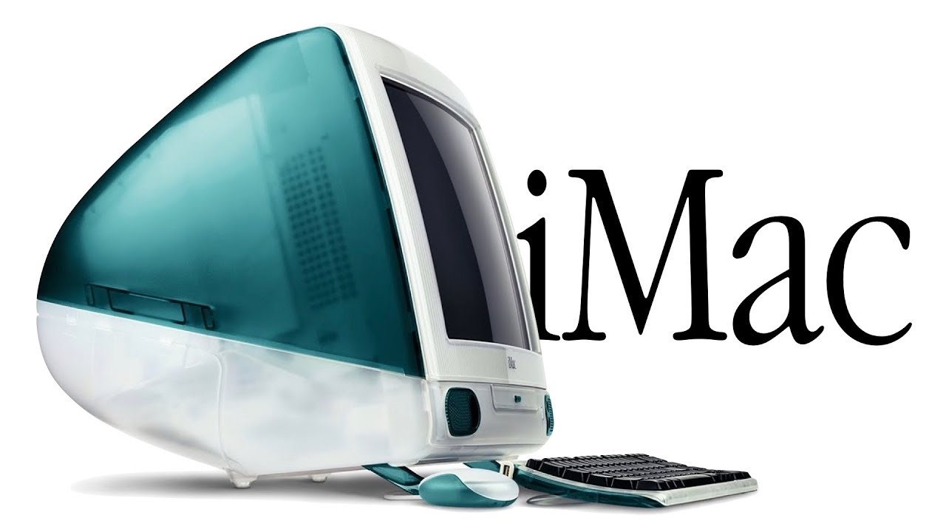
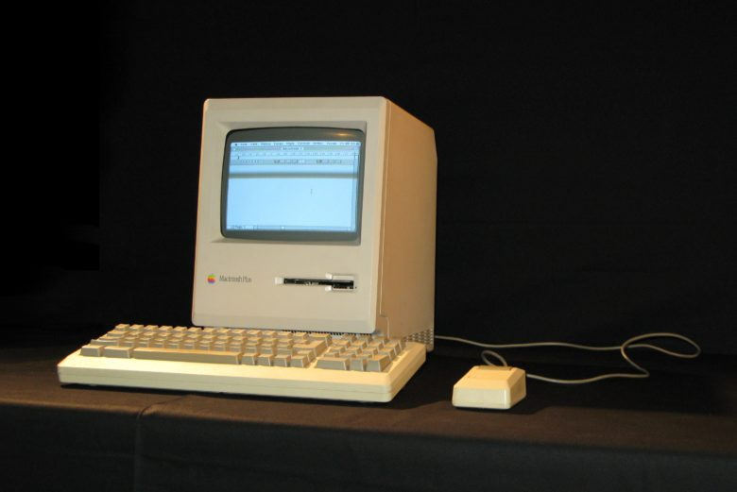
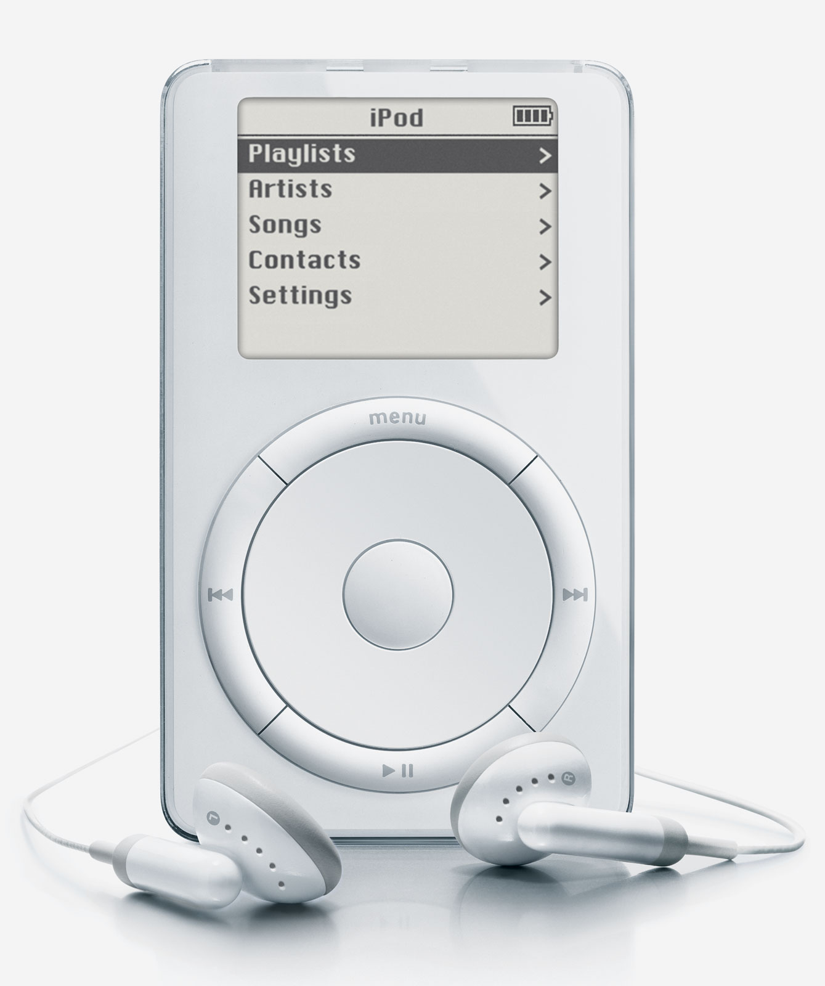

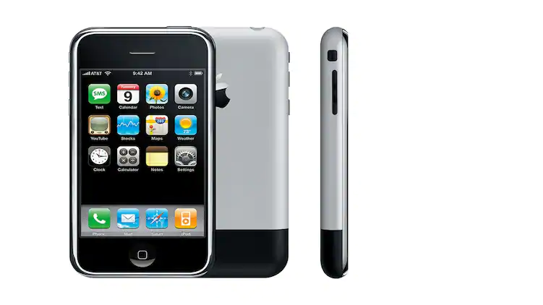
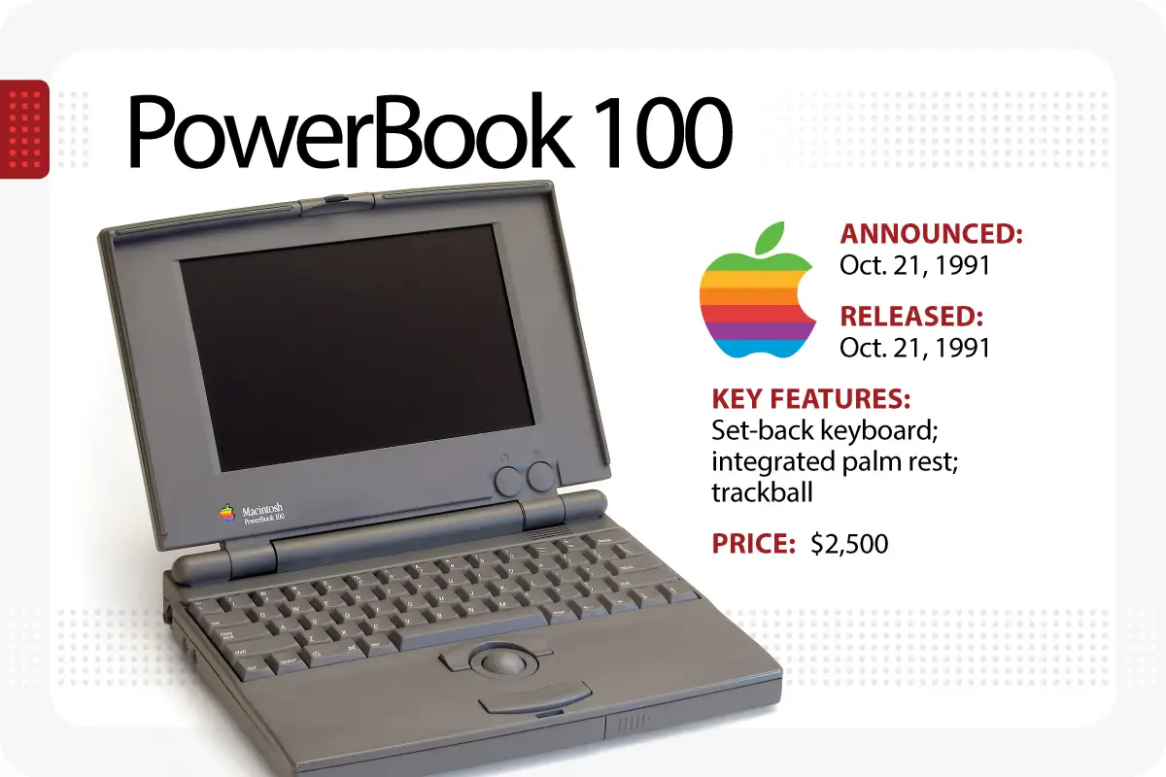
HISTORY OF APPLE COMPANY:
1977:first popular used pc
1997:Steve jobs returns to the company
1976:Steve jobs and Steve wozniak registered APPLE
1998:iMAC
1984:First PC with graphic interface
2001:IPod
Original logo from 1976
1985:Steve jobs leaves the company
1991:POWERBOOK(The notebook laptop)
2007:IPhone

Slide 17

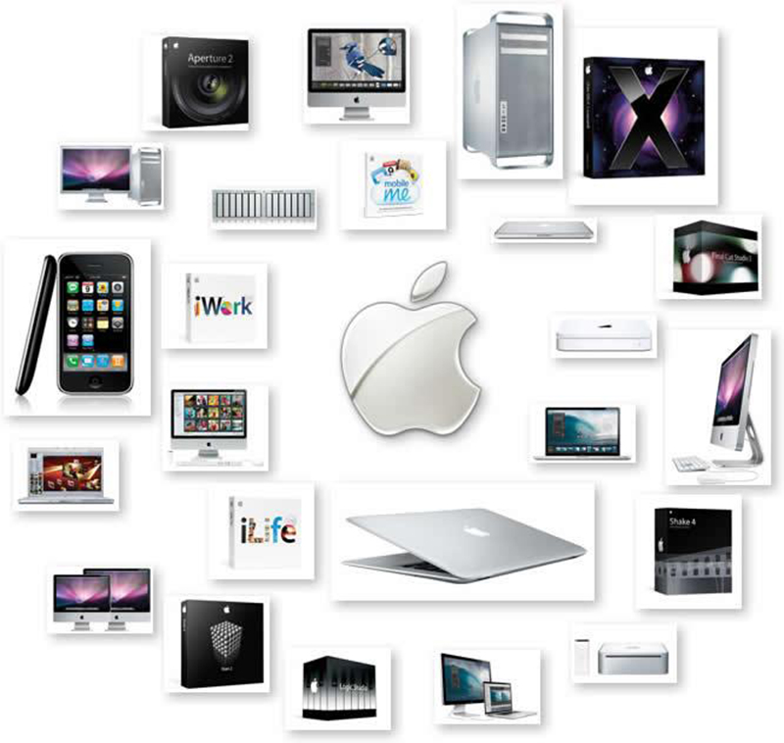
TODAY PRODUCTS OF APPLE
Apple Watch
iPhone
Apple TV
iPad
Air Tag
Macintosh
machos
iOS etc.

Slide 18
GLOBAL MARKET SHARE

Slide 20
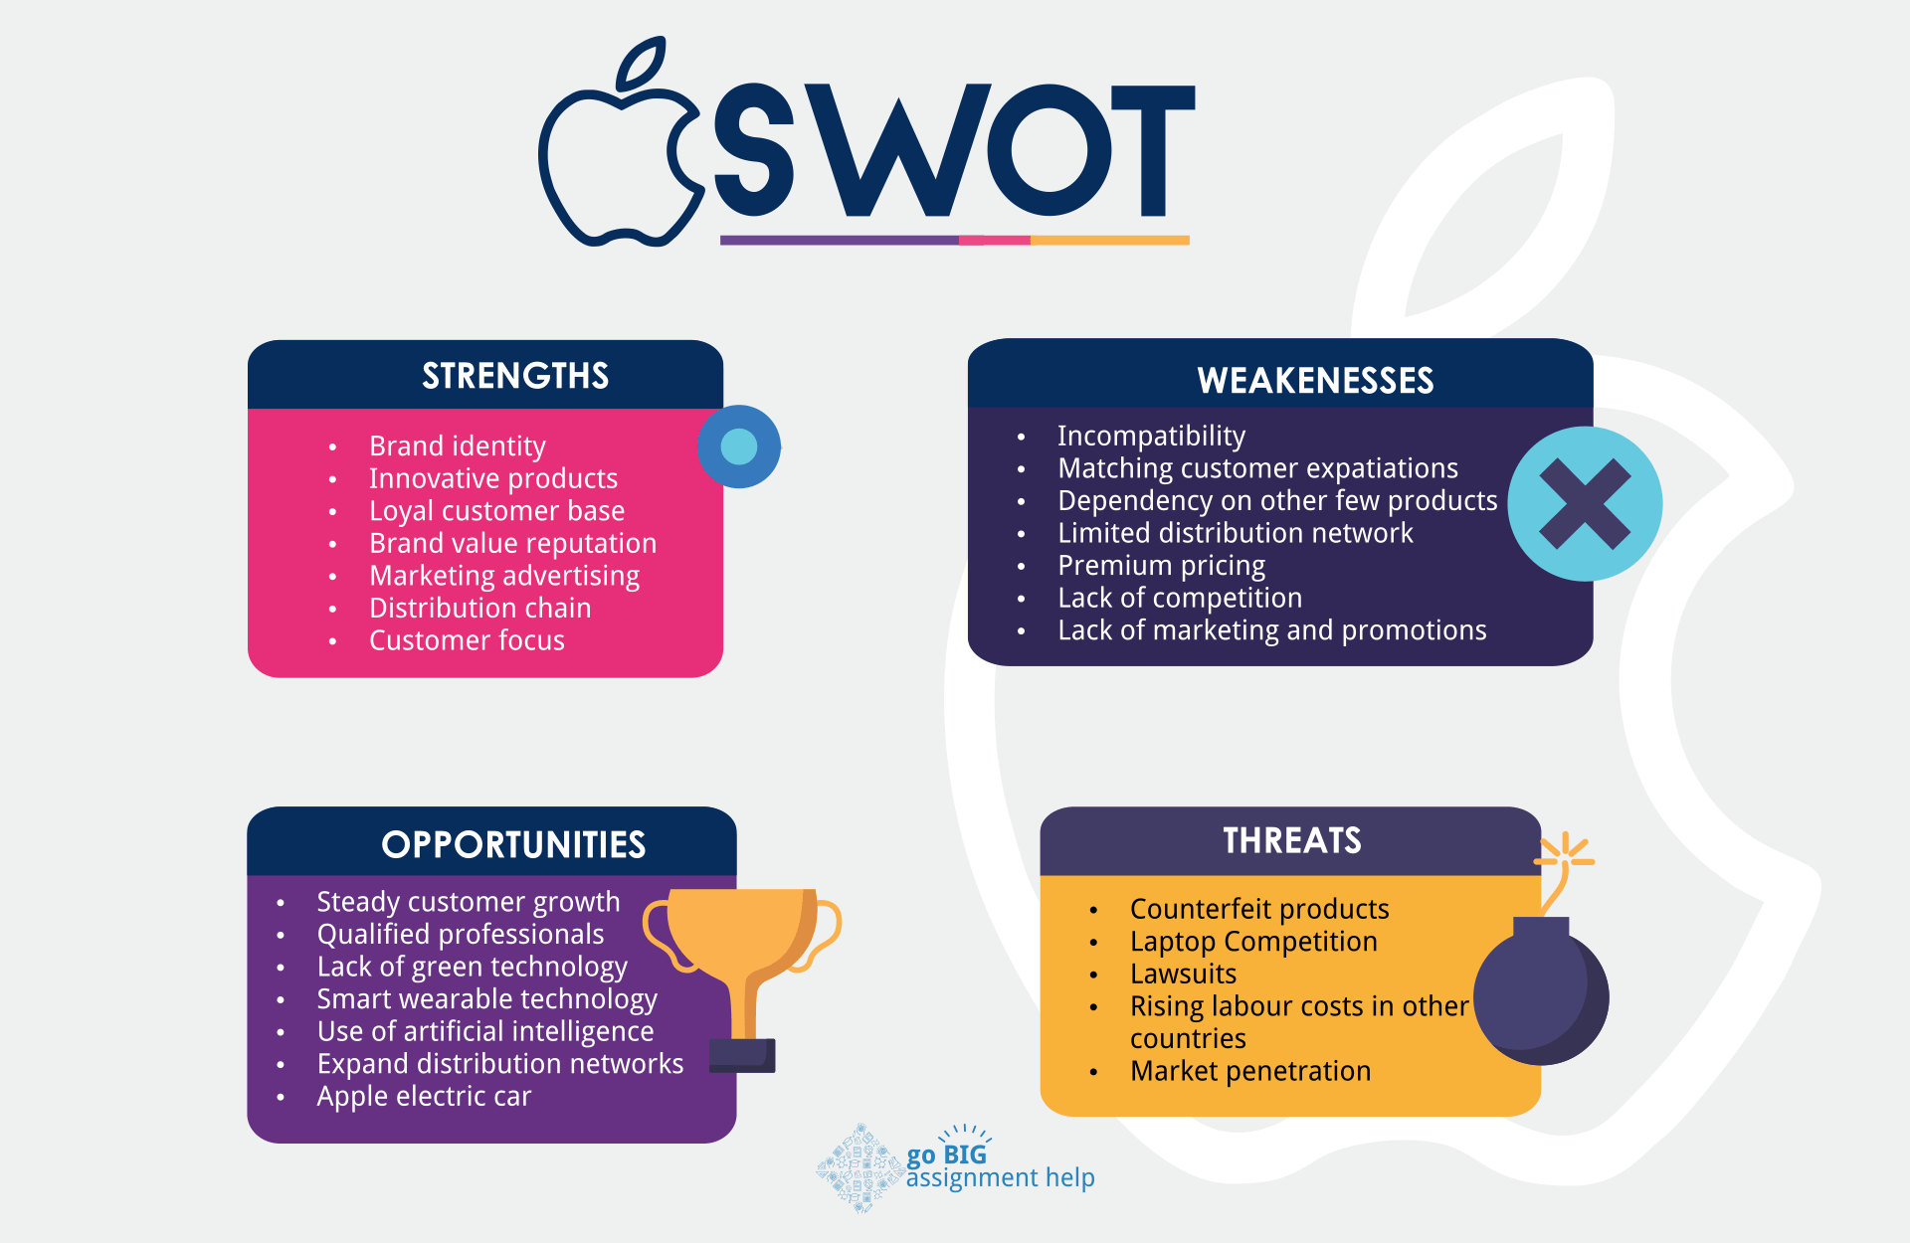

Slide 21
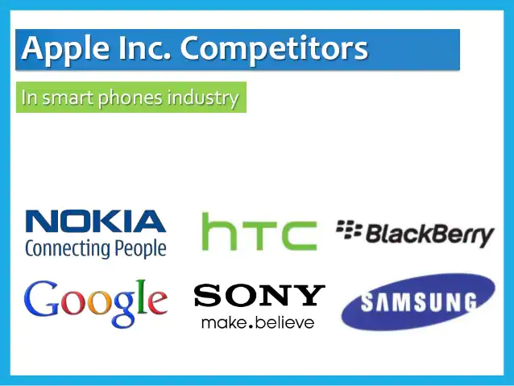
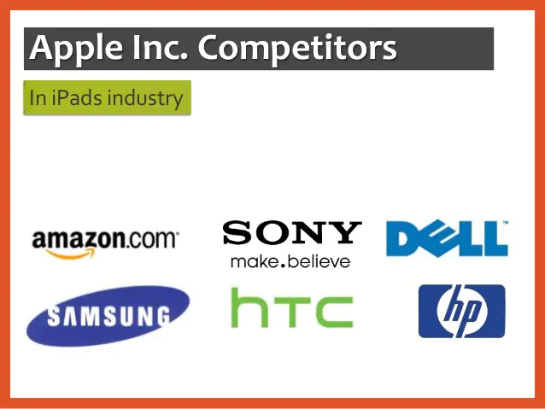
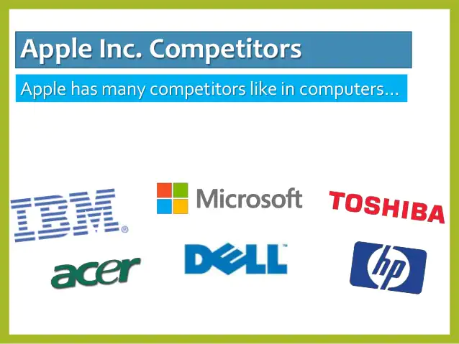
COMPETETORS OF APPLE COMPANY:

Slide 22

Any Questions?

